Slide 1

GRAPH THEORY AND ITS APPLICATIONS
Dr. Arti Arya
Department of Computer Science & Engineering

Slide 2

GRAPH THEORY AND ITS APPLICATIONS
DIRECTED GRAPHS
Dr. Arti Arya
Department of Computer Science & Engineering

Slide 3
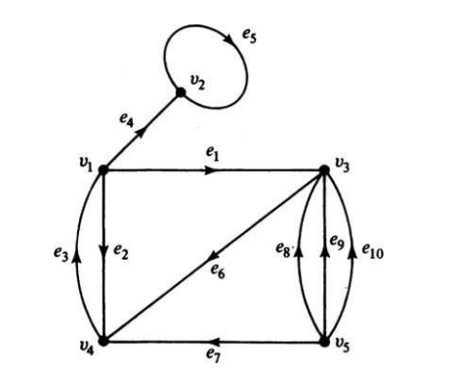

Graph Theory and its Applications Directed Graphs
A directed graph (or a digraph for short) G consists of a set of vertices V = {v1 , v2 , . . .}, a set of edges E = {e1 , e2 , . . .}, and a mapping Ψ that maps every edge onto some ordered pair of vertices (vi , vj ).
A digraph is also referred to as an oriented graph.

Slide 4
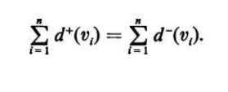
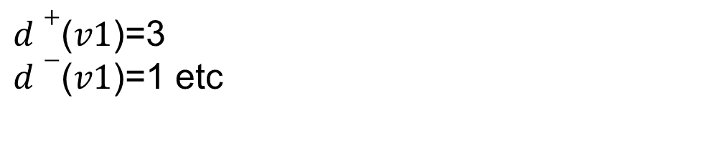
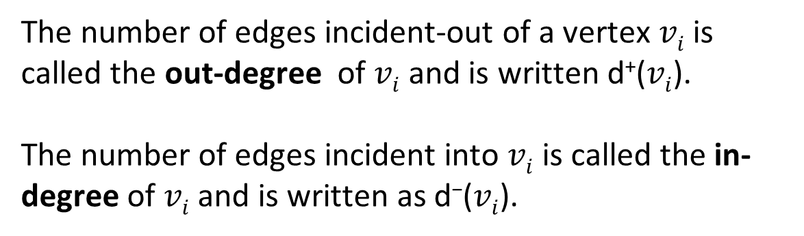

Graph Theory and its Applications Directed Graphs
The number of edges incident-out of a vertex $vi$is called the out-degree of $vi$ and is written d⁺($vi$).
The number of edges incident into $vi$ is called the in-degree of $vi$ and is written as d⁻($vi$).
$d+$($v1$)=3
$d−$($v1$)=1 etc
Also, in a digraph,

Slide 5

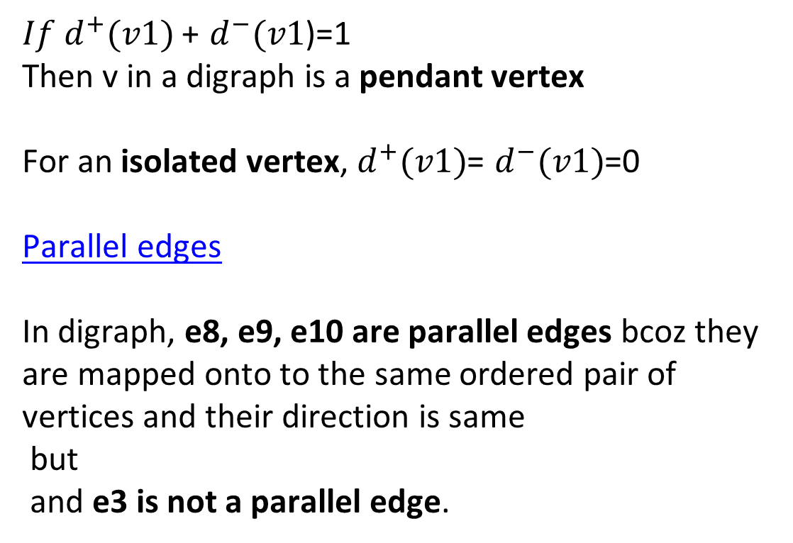
Graph Theory and its Applications Directed Graphs
$If d^{+}(v1)$+ $d^{−}(v1$)=1
Then v in a digraph is a pendant vertex
For an isolated vertex, $d^{+}(v1)$= $d^{−}(v1)$=0
Parallel edges
In digraph, e8, e9, e10 are parallel edges bcoz they are mapped onto to the same ordered pair of vertices and their direction is same
but
and e3 is not a parallel edge.

Slide 6

Graph Theory and its Applications
Binary Relations
A binary relation
A property that describes whether two objects are related in some way.
Examples:
Less-than: x < y
Divisibility: x divides y evenly
Friendship: x is a friend of y
Tastiness: x is tastier than y
Given binary relation R, aRb iff a is related to b. This relation could be
a = b
a < b
a “is tastier than” b

Slide 7
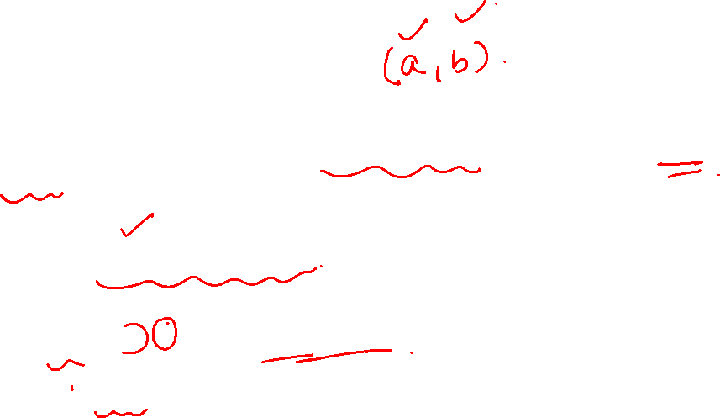
Graph Theory and its Applications
Binary Relations
Relations as Sets
Formally, a relation is a set of ordered pairs representing the pairs for which the relation is true.
Equality: { (0, 0), (1, 1), (2, 2), … }
Less-than: { (0, 1), (0, 2), …, (1, 2), (1, 3), … }
Formally, aRb ≡ (a, b) ∈ R

Slide 8
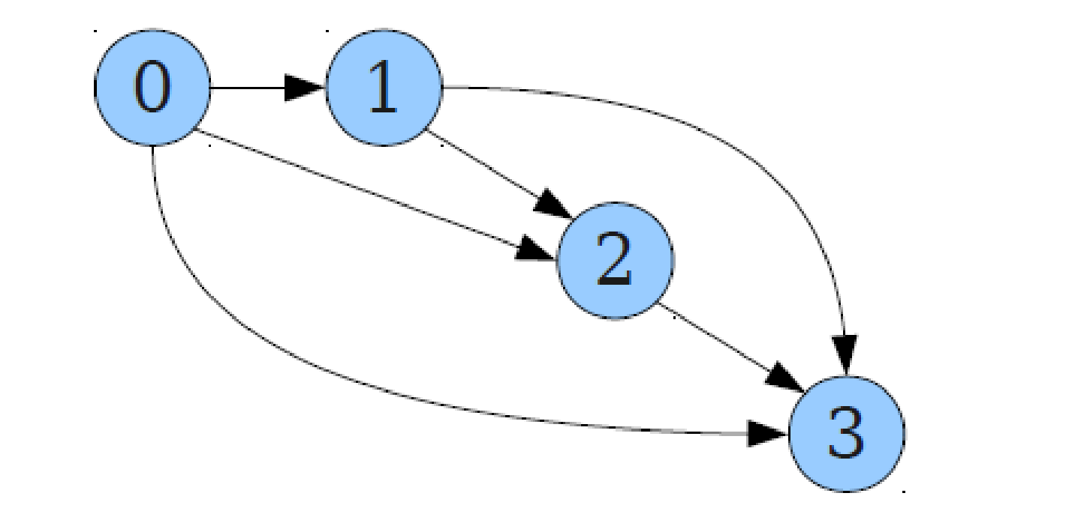
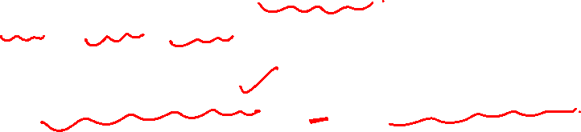
Graph Theory and its Applications
Binary Relations
Binary Relations and Graphs
Each (directed) graph defines a binary relation:
aRb iff (a, b) is an edge
Each binary relation defines a graph:
(a, b) is an edge iff aRb. Here R is existence of an edge.

Slide 9
Graph Theory and its Applications
Binary Relations
An equivalence relation has following 3 properties/traits:
Reflexivity
Symmetry
Transitivity

Slide 10
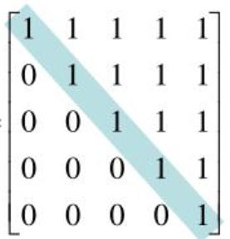

Graph Theory and its Applications
Binary Relations
Reflexivity
A binary relation R over a set A is called reflexive
( every element is related to itself)
iff For any x ∈ A, we have xRx.
Equality:
For any x, we have x = x.
Not greater than:
For any integer x, we have x ≤ x.
Subset:
For any set S, we have S ⊆ S.
Let A={1,2,3,4,5}
Diagonal elements being 1 means the node has a loop. So, these loops are defining the reflexivity for the graph.

Slide 11
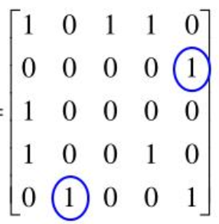
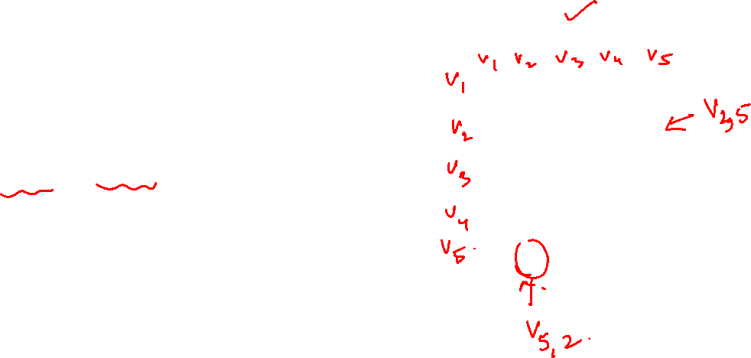
Graph Theory and its Applications
Binary Relations
Symmetry
A binary relation R over a set A is called symmetric iff For any x ∈ A and y ∈ A,
if xRy, then yRx.
Let A={1,2,3,4,5}

Slide 12
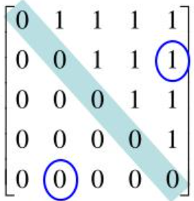
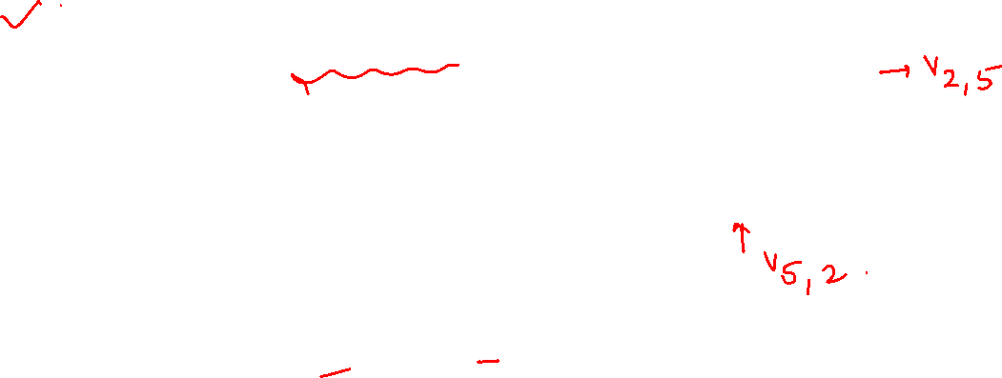
Graph Theory and its Applications
Binary Relations
Asymmetric: where a is related to b but b is not related to a
Antisymmetric: when a is related to b but b is not related to a unless a=b for all (a,b)

Slide 13
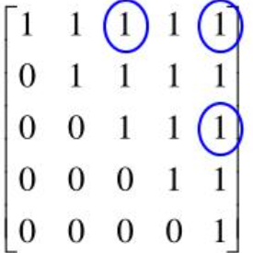
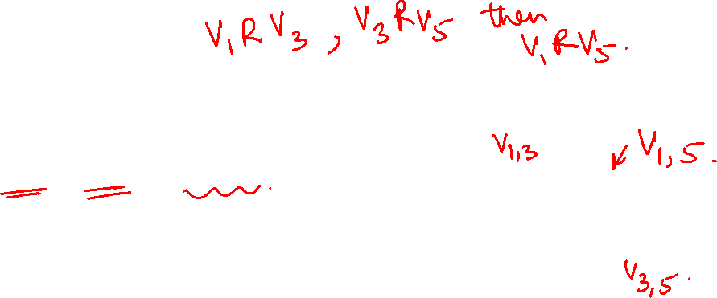
Graph Theory and its Applications
Binary Relations
Let A={1,2,3,4,5}
Transitive
A binary relation R over a set A is called transitive iff
For any x, y, z ∈ A, if xRy and yRz, then xRz.
E.g. Equality:
x = y and y = z implies x = z.
Less-than:
x < y and y < z implies x < z.
Subset:
S ⊆ T and T ⊆ U implies S ⊆ U.

Slide 14
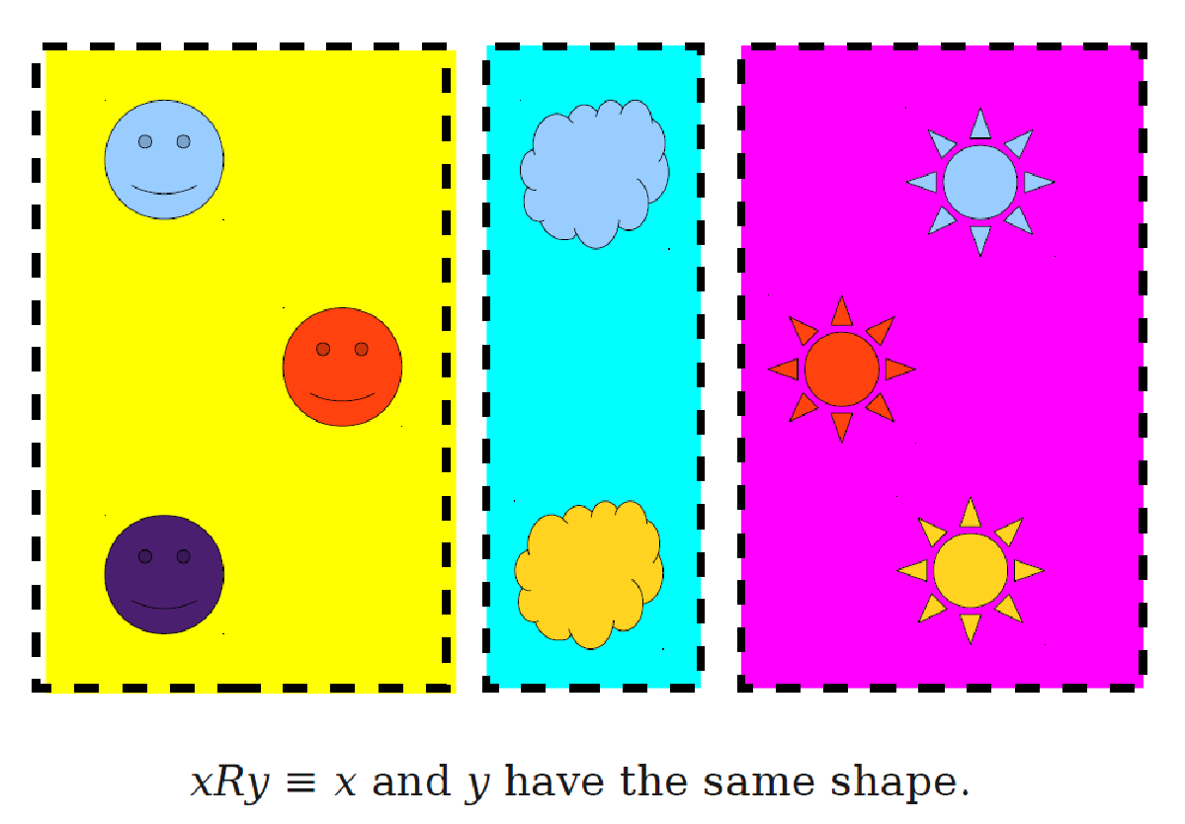
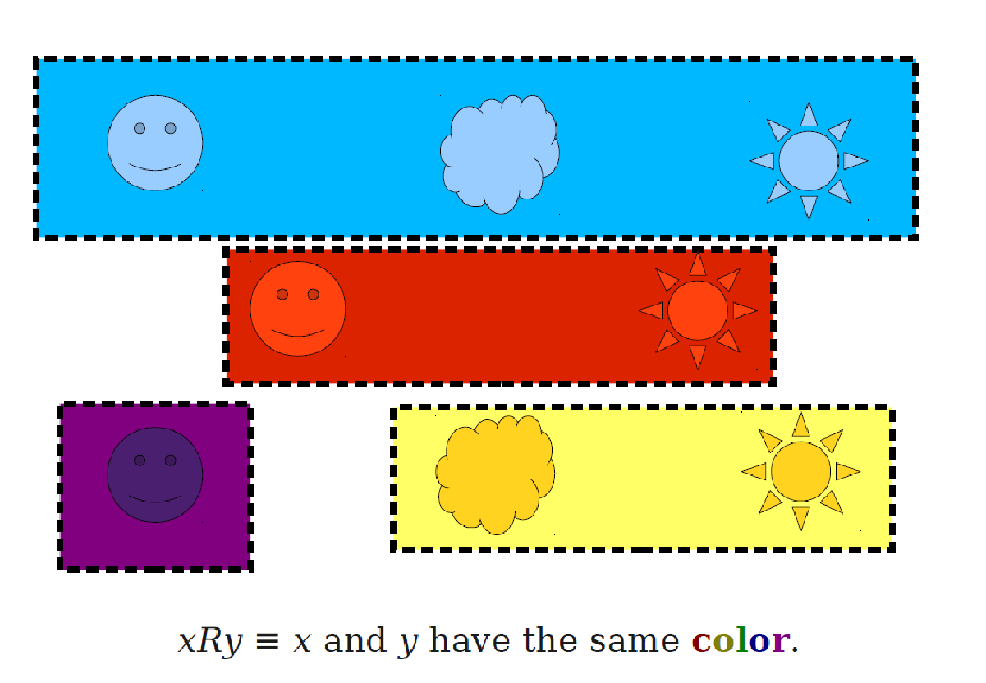
Graph Theory and its Applications
Binary Relations
Check for equivalence!

Slide 15
THANK YOU
Dr. Arti Arya
Department of Computer Science &Engineering
artiarya@pes.edu

